Slide 1
SEF
Testing – What is it all about?

Slide 2
Reading
Testing Explained and De-Mystified
Code Complete: Chapters 20, 21, 22

Slide 3

Why Bother Testing?
Testing Explained and De-Mystified
This is a question that a lot of new software engineers ask themselves…
  After all, its more fun to design and develop software then it is to do boring old testing ..
A good software engineer soon comes to realize that it is their responsibility to ensure that the systems and software they design and develop is actually functional and therefore problem free …
  They realize that problems can enter the process at any stage
  They realize that it just doesn’t make good business-sense to let the issues (bugs) get to the customer

Slide 4

Real-Life Example of Failed Quality Control
Testing Explained and De-Mystified
EPIC
FAIL !
James Earl Ray was the man convicted of assassinating Martin Luther King Jr. !!

Slide 5
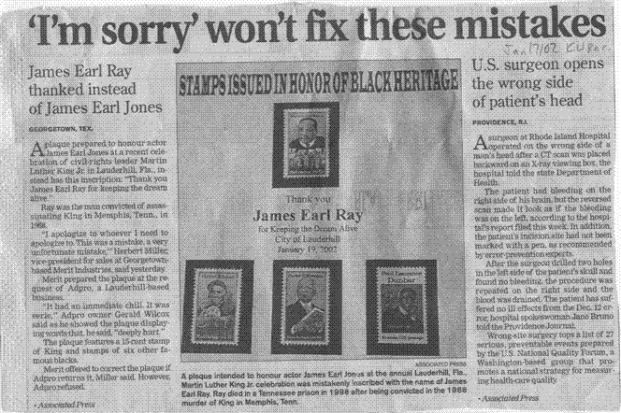
Testing Explained and De-Mystified

Slide 6
When is the Best Time to Test ?
Testing Explained and De-Mystified
Okay, so now we realize that we need to test our software and our systems that we develop … so when do we test ?
It is very tempting to reason that we can only really test our systems and software after it has been developed …
  But this is an incorrect assumption.
  In order to develop a quality system / piece of software it is essential that testing (and therefore quality) is considered throughout the system development process
It’s true !! As we are gathering and documenting the requirements we can begin to think of tests that we can run on the system to ensure that requirements are met
  I’m sure that a number of you were thinking about how you would design and develop the software for the Clock in Assignment #1 ☺
  We can record ideas about testing while gathering requirements, designing and especially developing the system
  We especially want to focus on error-prone areas

Slide 7
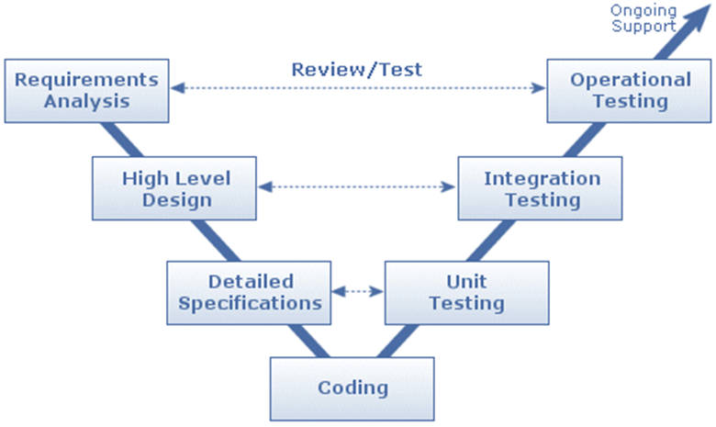
When is the Best Time to Test ?
Testing Explained and De-Mystified

Slide 8
Pre-Test Documents

Slide 9
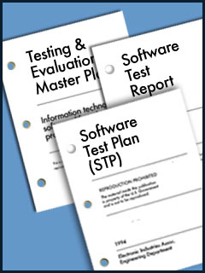
Test Documents
Testing Explained and De-Mystified
To help make sure that these testing ideas become part of the system development, three types of test documents are typically created at the start of any project
  Test Strategy
  Test Plan
  Test Specification

Slide 10
Test Strategy
Testing Explained and De-Mystified
This document actually should exist within your company before the company begins any project development.
The purpose of the Test Strategy is to officially document (for quality purposes) your company’s belief system
  In terms of what procedures the company follows in testing their products
  In terms of what tools the company will use in their testing
  . . .
Essentially this is document forms the Guiding Principles on a company’s best practices for testing

Slide 11
Test Specification
Testing Explained and De-Mystified
A Test Specification is a collection of all tests that will be executed for a piece of software. It is a detailed summary of
  What scenarios will be tested
  How they will be tested
  How often they will be tested
  . . .
  On a per feature / requirement basis
In the other Software Quality courses that you will be taking in SET, you will be taught the proper way to document these tests in your Test Specification ☺

Slide 12
Test Plan
Testing Explained and De-Mystified
In the development of a system there can be many different sub-systems / modules (as we will explore next term in SAaD)
  And it is quite possible that each of these sub-systems / modules may be considered within the project as standalone
  Therefore each sub-system / module requires its own Test Specification …
  In this case, a Test Plan is made up of the collection of Test Specifications for a more complex system
  The Test Plan will make reference to the Test Strategy when necessary
In the development of smaller systems, it is quite possible that the Test Plan and the Test Specification are actually the same document
  And in doing your reading, you may actually see these terms used interchangeably

Slide 13
Importance of Test Plan
Testing Explained and De-Mystified
While we were talking about the need for gathering requirements, I told you about some common reasons why some projects don’t actually gather requirements
  Often times based on the underlying idea of saving time and cutting corners
  The same idea is often times applied to the whole idea of testing … with potentially disastrous results !!
Despite the fact that a company may have a Testing Strategy which states “Thou shalt …” regarding testing policies and practices
  Companies continue to make the classic mistake #22
    "Projects that are in a hurry often cut corners by eliminating design and code reviews, eliminating test planning, and performing only perfunctory testing. ... Shortcutting 1 day of QA activity early in the project is likely to cost you from 3 to 10 days of activity downstream.“
Take this opportunity to learn from other people’s mistakes and never try to cut-corners by eliminating testing or under-valuing it !

Slide 14
What goes in a Test Specification ?
Testing Explained and De-Mystified
So what goes into a Test Specification you ask ?
From Sara Ford’s Weblog (Sara is a Visual Studio tester)
History / Revision
Feature Description
What is tested?
What is not tested?
Test cases
Breakout of Major Test Areas
More ...

Slide 15
Test Specification - Contents
Testing Explained and De-Mystified
History / Revision
  Who created the test spec?
  Who were the program managers, project managers, and developers at the time when the test specification was created?
  When was it created?
  When was it updated?
  What were the major changes at the time of the last update?
Feature Description
  Brief description of what area is being tested – what feature of the system?
What is Tested ?
  A quick overview of the scenarios being tested
What is Not Tested ?
  A quick overview of scenarios not being tested and why ?
  Perhaps they were tested elsewhere – in which case provide the reference

Slide 16
Test Specification – Contents (cont’d)
Testing Explained and De-Mystified
Test Cases (she refers to them as Nightly Test Cases)
  List of individual test cases – she indicates nightly because these are the test cases that should be run each night on a developing system – or at least whenever a new release is being made available
Breakout of Major Test Areas
  Arrangement of test cases according to what they are testing:
    Functionality Tests
    Structural Tests
    Security Tests
    Accessibility Tests
    Stress Tests
    Performance Tests
    Edge cases (Boundary Conditions)
    Globalization
Keep in mind that this format for a Test Specification is the way that Sara does it .. It may not be the way that your company does …
  You’d have to refer to your company’s Test Strategy for details on how to document your Test Specification

Slide 17
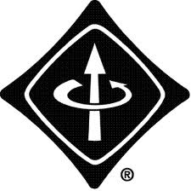
IEEE to the Rescue !!
Testing Explained and De-Mystified
As you might expect, the IEEE has weighed in on this topic of a standard for a Test Specification
  Good ol’ IEEE ☺
For this reason a number of companies have adopted this standard as their standard …
  IEEE 829 Specification (Background)
Also note that there are samples of Test Specifications and documents in the supplementary reading material …

Slide 18
Sean’s Way … ☺
Testing Explained and De-Mystified
As we will learn (in a couple of slides from now) there are different levels of testing
  … and when it comes to Unit Testing, there is an (almost) industry-wide way of documenting the various test cases
A Unit Test Description contains:
  Test identifier
    A unique identifier - usually a number (or dotted number)
  Short description of the test
  Method of execution
    Manual, automatic, sequence of operations, etc.
  Input data (and/or input commands)
  Expected outputs (data, messages, exceptions)
  Observed outputs
  Resulting actions if test fails

Slide 19
Test Philosophies

Slide 20
Test Philosophies
Testing Explained and De-Mystified
When it comes to testing, there are two different schools of thought …
Software testing is intended to verify that software meets its requirements
The purpose of software testing is to find errors
A common issue of testing is that people tend to find what they are looking for …
  So if you have developed a test to prove that your software performs correctly and meets requirements, then that is generally what you will conclude
    As an aside, never rely on testing your own software as the main method of testing.
      Test your own software before it's ready to be integrated with others' work
      Test your own software before the main testing phase.
  If instead someone else (not you – the developer of the code) develops tests for the system – then more errors may tend to be found
    Since the person writing the tests is not aware of how the code actually works – they are testing to the written requirements
Let’s talk about some different types of tests that can be run on software …

Slide 21
Types of Tests

Slide 22
Functional Testing
Testing Explained and De-Mystified
Also called specification-based testing, requirements testing or black-box testing (I refer to it as normal testing)
  This type of testing is directly tied to the SRS and is trying to verify and validate that all of the things (requirements) that the system is supposed to be able to do, it can.
    Functional testing is often an enormous set of tests, so you will need to set a specific reasonable limit on the number of tests
    Remember that you are required to test each specification in the SRS – so this is why you need to limit your testing points to make this practical

Slide 23
Fault-Based Testing
Testing Explained and De-Mystified
This type of testing is often times called exception testing
What you set out to do in this type of testing is try to imagine where faults (or exceptions) could occur in your software / system and test for them
  This quite often involves knowledge of the innards of the product in order to determine where flaws might occur
  The idea behind these tests is to show that your design has thought about these conditions and programmed in a nice way to handle them – without crashing !!

Slide 24
Boundary Testing
Testing Explained and De-Mystified
This type of testing checks what happens with your system / software at the extremes of inputs
  Your tests should include testing values before, on, and after a boundary
  For example
    Let’s say that you have a function that takes a floating point value as input
    This function expects this parameter value to be in the range 1.0 through 10.0
    Normal / Functional tests might test with the values 5.3, 8.2, etc.
    Boundary tests might test with the values 0.9999, 1.000001, 9.9999 and 10.0001
    Exception tests might test with the values 0, -5.2 and 1000.2

Slide 25
Interface Testing
Testing Explained and De-Mystified
As I have described in other SEF lessons, each time you develop a function or method
  And define it through a prototype – you are really defining the interface of your software
This type of testing requires that you examine the interface (calling mechanism) to a module and try to see how it could be interacted with incorrectly
Examples:
  order of parameters wrong
  parameter meaning wrong (e.g. units)
  restrictions on parameters ignored

Slide 26
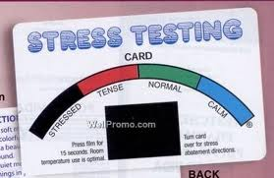
Stress Testing
Testing Explained and De-Mystified
This type of testing is also known as angry testing
The object is to give the system more than it is designed to handle and see how it behaves
  Sometimes, the idea is to increase the load until it fails
    This tests the failure behaviour of the system to make sure that it is acceptable
    This also may cause other faults to become evident
e.g. Infrared keypad testing
  Press a lot of keys at the same time
  Press keys very rapidly
  Try from beyond the specified maximum range

Slide 27
Levels of Testing

Slide 28

Levels of Testing ??
Testing Explained and De-Mystified
Hang on here … you have just accepted the fact that you need to test – as responsible software engineers
Then I told you about some common types of tests (normal, exception, etc.)
  And believe me when I say there are many, many more types of tests
Now I’m telling you that there are different levels to testing ?!?!?
  When will this madness end ??

Slide 29
Unit Testing
Testing Explained and De-Mystified
Testing of individual units before they are combined into the system
  Test both the unit and the interfaces to other units
  This type of testing is carried out by the developer of the unit / module
Sometimes involves building dummy utilities to provide input or output facilities
  For example, if the function (unit) that you are testing calls upon another function (which may not have been developed already) – then you need to stub out that other function so that your function will operate
Unit Testing occurs before the units are merged into the system
  If the units are functions with interfaces, the interfaces should be well-documented so that they can be tested
Often called "white-box testing", as you make use of your knowledge of the internals of the system to design proper tests

Slide 30
Unit Testing: How?
Testing Explained and De-Mystified
Isolate each unit and set up a dummy driver routine (called a test harness) that sends inputs into its interfaces
This is most easily done when your code is highly modular and many source files are used to make up your system
Excellent aid: good, accurate function comments

Slide 31
Unit Testing Scenario
Testing Explained and De-Mystified
Example
  C Assignment #2: the function that calculates the power can be considered a unit that can be tested
  Isolate it from the rest of the system
  Write a main() that sends values to the function and see what happens, testing to see if the desired result is achieved
    This new main() that you develop which only calls the power function would be called your test harness
    The test harness can be set up to throw values at the unit being tested and record the result for later checking
      It can send normal values to the function …
      It can send exception values at the function …
      It can send boundary values at the function …

Slide 32
Need for Stubbing …
Testing Explained and De-Mystified
As mentioned, it is sometimes the case that your module uses other modules/functions that are not ready yet
In this case, you need to create stubs that either do nothing or behave like the function that it's replacing
  This is a common technique employed by all developers and in fact, it is common practice that when beginning a new system’s development – most developer’s begin by stubbing out all of the functions / methods that they will be developing
    What they are really doing is implementing the interface for the software

Slide 33
Integration Testing
Testing Explained and De-Mystified
As each developer completes their set of functions and completes their unit testing of the functions – there is a need to begin to integrate the units together to begin forming the system
  Integration Testing is used to determine how various units work together
  In this case, we are testing two or more units
  Tested in some organized order
  Assumes that unit testing has completed, more or less
  This type of testing is carried out by the developers involved in creating each of the units being integrated

Slide 34
System Testing
Testing Explained and De-Mystified
Once all sets of units have been integrated together and tested into larger and larger collections – it reaches a point where the entire system has been assembled. At this point, the testing is known as System Testing
  Testing of the entire system once complete (or somewhat complete)
  Each test tests several parts of the software
  Tests check how different parts of the software interact with one another
  Test valid and invalid inputs
  Test plan traditionally details system testing and not unit testing
  Use cases are often taken from the SRS to use here
  This type of testing is usually carried out by QA Dept.

Slide 35
User Acceptance Testing
Testing Explained and De-Mystified
Once you and your company have done your due diligence and unit tested, integration tested and system tested … and you are happy with the results and you believe that you have a stable, well performing system – you release it
This is where the customer takes possession of the system
  But they just don’t take it and say “Thank you very much” – No! They reserve the right to perform their own set of independent tests
    UAT is to be performed by the customer or a representative of the customer
  To make sure that what they believed they asked for has actually been delivered – these are called user acceptance tests
    Generally this is a collection of system-level tests to run the delivered system end-to-end to ensure that everything happens properly

Slide 36
Regression Testing
Testing Explained and De-Mystified
Let’s imagine that your software has been released and has been user-accepted.
  As mentioned earlier in the course, the customer will often times come back to you and ask you for changes (new features, modified features) to the software – or inevitably bugs will slip through the cracks and the customer will begin to report them
Regression testing refers to the retesting of the system after testing has been done, bugs have been found, and changes have been made
  Often regression testing includes a subset of Unit/Integration/System tests
    As a result, regression testing is carried out by individual developers (for unit), multiple developers (for integration) and the QA department (for system)
  In theory, should retest with the entire test suite but often times you regression test a representative sub-sample of all tests
    Especially concentrating on the area of code just modified

Slide 37
Test Results
Testing Explained and De-Mystified
Just as we began our testing lesson talking about documents that need to be written and what they contain
  You can imagine that for completeness sake, it is recommended that you document the results of tests
  You do so in order to prove that testing occurred, by whom, how, etc.
  This is usually called a test log – and (thankfully) there is no standard way of documenting these results …

Slide 38
Possible Test Log Information
Testing Explained and De-Mystified
Transaction number
  A unique identification code for the test log entry
Test start date / start time
  The date and time that the test started / was run
Test name
  The name or identifier for the test being run.
System version
  Which version of your software you are testing
Test stage or step
  What area of code you are testing? what level of testing is this ?
Test inputs
  this describes the test inputs at each stage or step of the test. Depending on the nature of the product and the testing, it may be necessary to create a separate log for the specific steps and inputs of the test in order to keep the test log from being too cluttered with specific step/input information.
Test results
  Test outputs
Operator comments
  specific comments regarding the test that may be useful when performing subsequent analyses.

Slide 39
Mission Critical Systems
Testing Explained and De-Mystified
A Mission Critical System is a system where failure could result in physical harm or significant loss
  e.g. software in an airplane, software running some patient medication/monitoring system, nuclear reactor
In the case of systems such as these, the need for extra care when testing is obvious
  We experience these critical systems in our lives every day
  Some licensing agreements for software restrict their use in critical system situations
So how do we adequately test systems such as these ??

Slide 40
Proof By Contradiction
Testing Explained and De-Mystified
Do a hazard analysis of the system to determine what can go wrong
  In your analysis, you need to choose an unsafe state
Next, you analyze the code to prove / show that the preconditions required in the software in order to be in this unsafe state cannot exist
  That is – it is impossible given the logic of the code to have the software be in such a state that this unsafe state exists
  Since you have proven that the software cannot exemplify this unsafe state – it therefore proves that this unsafe state cannot exist the software
Repeat for all identified unsafe states

Slide 41
Run-time Safety Checking
Testing Explained and De-Mystified
Another technique for testing mission critical systems is to perform run-time safety checks
  This is where you check safety issues in the code on an ongoing basis
    e.g. for an Insulin Pump System, your software may choose to do safety checks on itself every minute – you would check the amount of insulin being administered and if it is too high then set off an alarm and reduce the dose
  These types of run-time checks might also be called sanity-checks … to make sure (as your program is running) that it is operating within suggested safety guidelines

Slide 42
Limited Example
Of Unit Testing the rangeCheck() function

Slide 43
Testing Explained and De-Mystified
In order to perform unit testing on this single function, we would
  extract the function from our solution
  make a new main() [our testHarness] that will be used to call rangeCheck() over and over with different verifiable test cases.
  Display and verify the results of the function calls
This sounds sooo simple !!
Let’s have a look at the sample Unit Testing code on the course website …

Slide 44
Testing Explained and De-Mystified
// --------------------------------------------
// This is the function we want to test …
// --------------------------------------------
int rangeCheck(int checkNumber, int min, int max)
{
int response=0;
if ((checkNumber >= min) && (checkNumber <= max))
{
response =1;
}
return response;
}

Slide 45
Testing Explained and De-Mystified
// ------------------------------------------
// So we develop our front end for testing
// … this function acts as the entry point
// for our mainline testHarness to get
// at and call the function …
// ------------------------------------------
void testRC(char* testType, int value, int min, int max)
{
int retCode = 0;
// let's call the rangeCheck() function first - so we can interpret the answer that
// comes back to output a more meaningful value
retCode = rangeCheck(value, min, max);
if(retCode == 0) // value not in range
{
printf("%10s%10d%10d%10d%20s\n", testType, value, min, max, "Not in Range");
}
else
{
printf("%10s%10d%10d%10d%20s\n", testType, value, min, max, "In Range");
}
}

Slide 46
Testing Explained and De-Mystified
// ------------------------------------------------
// Then we develop our mainline testHarness
// which tests the function via the front-end
// ------------------------------------------------
int main(void)
{
int i = 0;
// set up a nice output table so we can view the results
printf("Unit test for rangeCheck()\n");
printf("%10s%10s%10s%10s%20s\n", "Type", "Value", "Min", "Max", "Result");
// test some arbitrary values (normal and exception)
testRC("Normal", 10, 1, 100);
testRC("Normal", 10, 10, 100);
testRC("Exception", -3, 4, 18);
testRC("Exception", -1000, -100, 30000);

Slide 47
Testing Explained and De-Mystified
// Next, we test some boundary conditions
testRC("Boundary", 0, INT_MIN, INT_MAX);
testRC("Boundary", INT_MIN, INT_MIN, INT_MAX);
testRC("Boundary", INT_MAX, INT_MIN, INT_MAX);
testRC("Boundary", INT_MIN, INT_MIN+1, INT_MAX);
testRC("Boundary", INT_MIN+1, INT_MIN+1, INT_MAX);
// …
// finally we test some random numbers (stress test)
srand(time(NULL)); // seed the pseudorandom generator
for( i = 0; i < 10; i++ )
{
testRC("Stress", rand(), rand(), rand());
}
// …
return 0;
}

Slide 48
Diagrams
Of concepts from this lesson

Slide 49
Testing Explained and De-Mystified
The following set of diagrams and charts were created in order to visually convey the ideas and concepts presented in this lesson

Slide 50
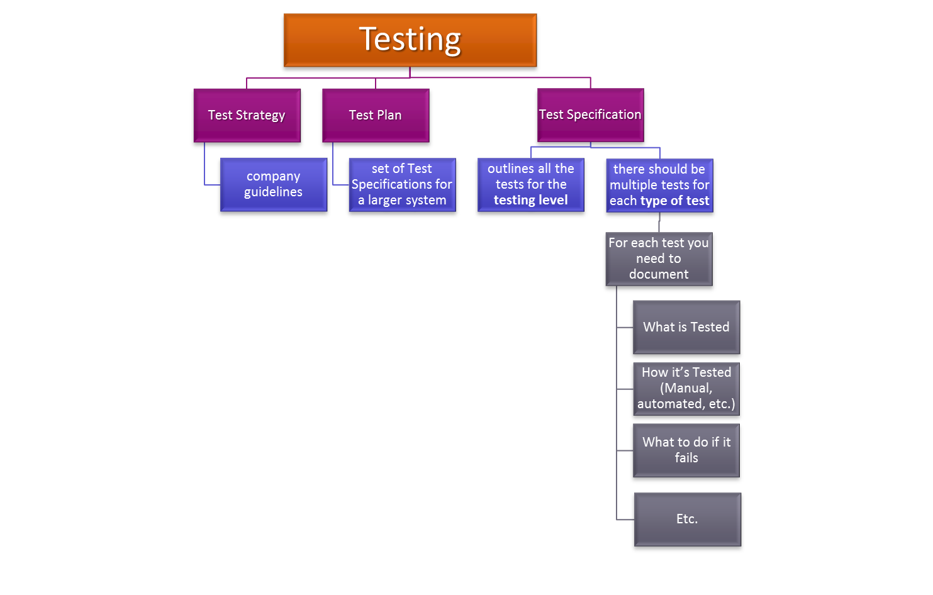
Testing Explained and De-Mystified

Slide 51
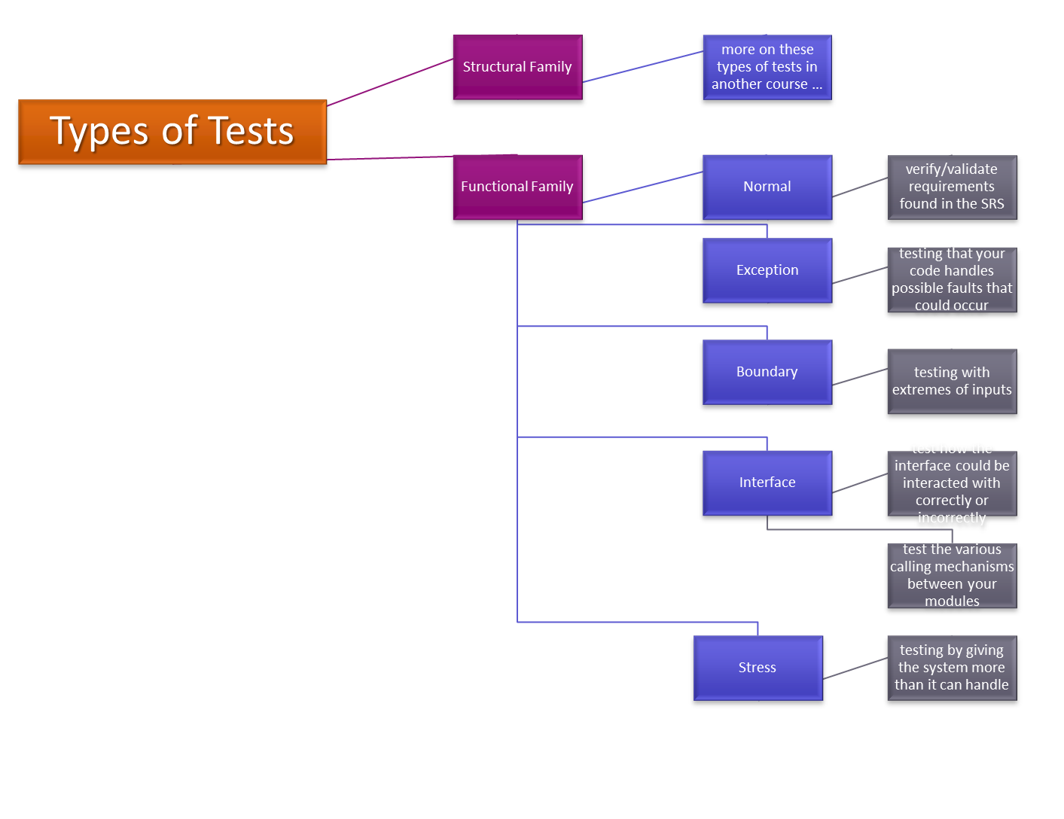
Testing Explained and De-Mystified

Slide 52
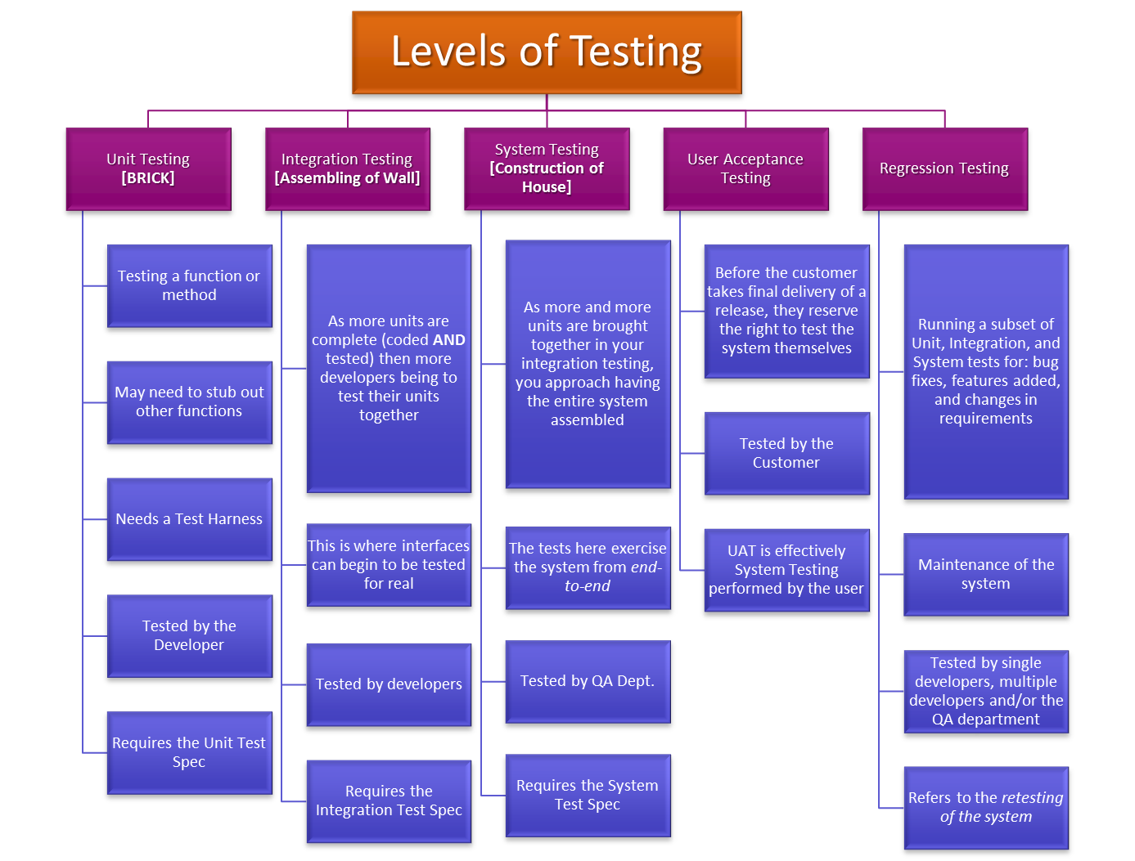
Testing Explained and De-Mystified

